Slide 1

YOGX
YOGX
YOGX
Elevating Your Yoga Experience

Slide 2

Title: "YOGX - Elevating Your Yoga Experience"
Subtitle: "AI-Powered Pose Feedback for Safer and More Effective Yoga Practice"
Team Members: Rohan Raghav, Nikita Singh, Sanchit Wadehra, Ishan Dev
Introducing YOGX: Your ultimate companion for safer, more effective, and rewarding yoga practice. Join us on a journey to elevate your yoga experience with cutting-edge AI technology.

Slide 3

INTRODUCTION
Our project seeks to create a Yoga Pose Detection Website using AI and webcam technologies. Users may use this platform to do yoga at home and receive immediate feedback on their posture. Our method assures optimal alignment through posture identification, resulting in a safer and more productive yoga practise.

Slide 4

PROBLEM STATEMENT
Problem: Incorrect yoga poses can lead to serious injuries.
Importance: Proper form is critical to prevent injury and maximize benefits.
Purpose: YOGX provides real-time pose correctness feedback to prevent injuries and promote safe yoga practice.

Slide 5

PROPOSED SOLUTION
YOGX
YOGX is an AI-powered platform that makes yoga practice easier. Users select a pose and place their mobile device in front of them, facing the camera towards themselves. YOGX's AI then analyses the user's pose and provides real-time feedback through sound and on-screen cues.

Slide 6
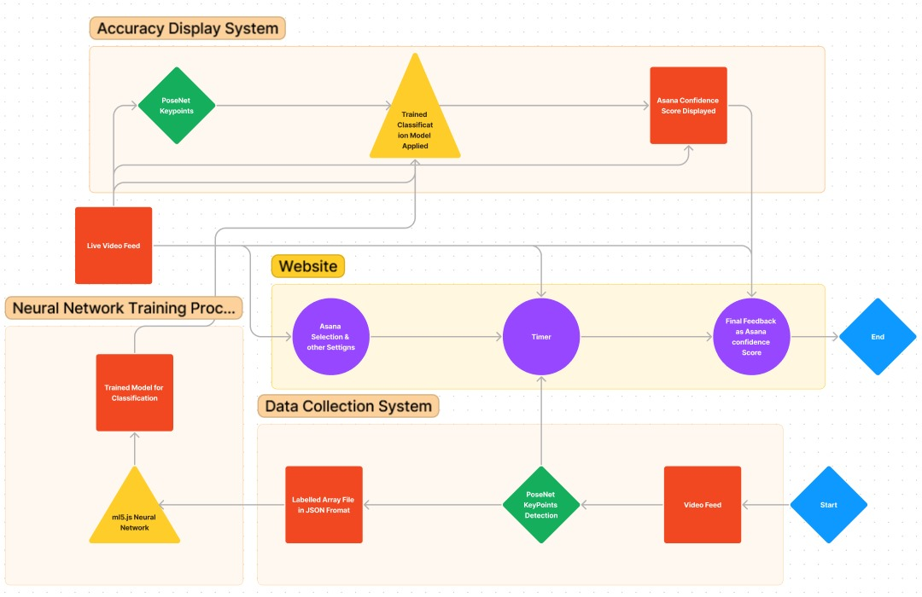
FLOWCHART

Slide 7
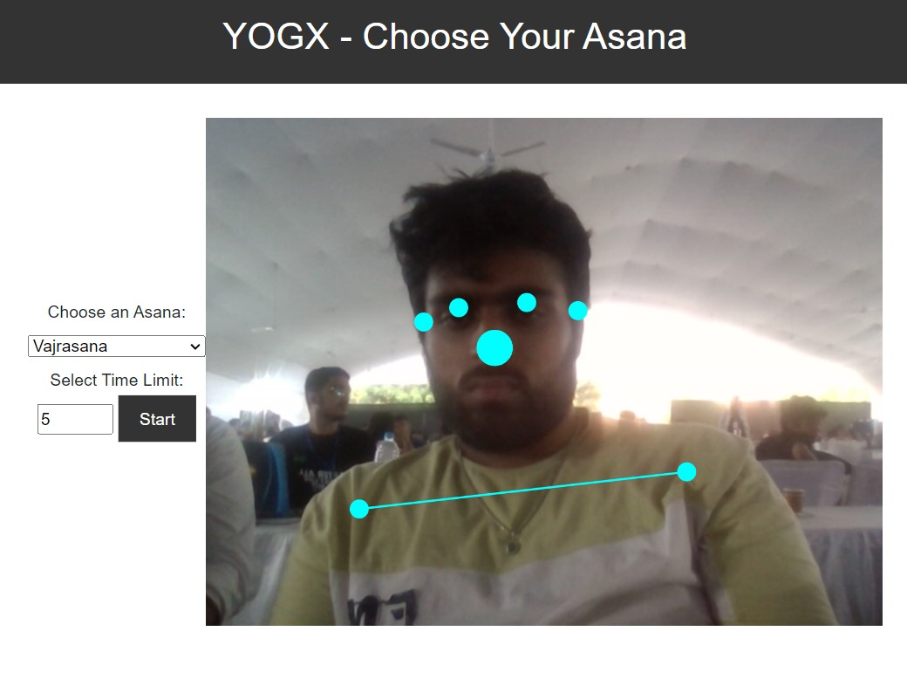
How It Works
Select Pose:
Choose a yoga pose from our diverse selection.
Device Setup:
Place your device with the camera facing you.

Slide 8
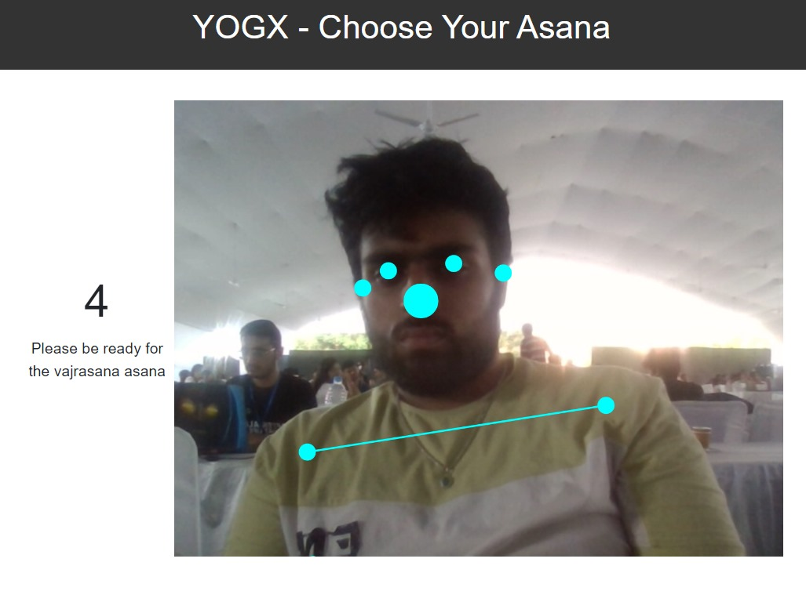
AI Analysis:
YOGX's AI assesses your pose in real-time.
Immediate Feedback:
User-Friendly:
Receive feedback through audio and visual cues.
Our interface ensures a seamless yoga experience for all levels.

Slide 9
Benefits of YOGX
Improved yoga practice.
Reduced risk of injury.
Increased motivation for home practice.
Accessible and user-friendly.

Slide 10
Challenges and Future Work
Future scope:
Challenges:
YOGX is just the beginning. We envision expanding our platform into a comprehensive AI trainer application.
To complement yoga practice, we plan to integrate dietary recommendations.
Achieving high accuracy in pose recognition remains a technical challenge.
Expanding YOGX to a global audience requires addressing language barriers and cultural nuances.

Slide 11
Conclusion
Reflecting on Our Journey: Our journey with YOGX has been filled with innovation, dedication, and a deep passion for promoting healthier living through yoga and well-being.
Empowering Wellness: YOGX is more than just a project; it's a commitment to empowering individuals on their path to wellness. With YOGX, we've created a foundation for safer, more effective yoga practice.
A Vision for the Future: As we look to the future, our vision extends beyond YOGX. We aspire to transform it into a holistic wellness hub, a comprehensive AI trainer, and a global community for health enthusiasts.

Slide 12

Thank You
Thank You
Thank You

